Slide 1




Module 7 – Key Concepts of Mitigation
Training Modules for Applying the Mitigation Hierarchy:
Planning Policy and Projects for No Net Loss or a Net Gain of Biodiversity
Module 7
Key concepts of mitigation

Slide 2
Key concepts of mitigation – Abstract
To supplement other modules (such as the modules on the Mitigation Hierarchy and on Biodiversity Net Gain), this module expands on some key concepts. It places these in context by describing the two principal phases of mitigation (design and implementation) and some key scientific and technical issues in offset design.
The module explains that there are limits to the losses of biodiversity that can be offset.
It describes spatial planning as the context for applying the mitigation hierarchy, from the national level, through regional or provincial planning and down to the local level.
The module introduces the principle of additionality and the baselines from which this can be determined, describing different ways in conservation gains can be secured and exploring whether restoration and the alternative of protection (or averted loss) can result in gains.
It also considers the specific question of whether offsets within protected areas can satisfy the text of additionality.

Slide 3
Key concepts of mitigation module - Contents
Contents | Slides
Introduction: design and implementation phases of mitigation; key scientific and technical issues & offset design | 4-6
Limits to what can be offset | 7-11
Spatial planning | 12-17
Additionality and baselines: Importance of additionality, what counts as gain, and counterfactuals. | 18-28
Will restoration result in gains for biodiversity? | 29-35
Will protection result in gains for biodiversity? | 36-43
Take home messages | 44

Slide 4
Topics covered in other modules
The following key concepts to do with mitigation are covered in other modules:
Issue | Modules on the issue
Following the mitigation hierarchy, especially ‘avoid’ Alternatives analyses | Mitigation hierarchy module Impact assessment module
Impacts that cannot be offset (‘non offsetable impacts’) | This module – ‘Key Concepts’
No Net Loss of what? No Net Loss relative to what How to achieve gain - different mechanisms (protection, restoration, creation…) | No Net Loss/Biodiversity Net Gain Module NNL/BNG Module and This module – ‘Key Concepts’ This module – ‘Key Concepts’
Reference scenarios and baselines Additionality | This module – ‘Key Concepts’ This module – ‘Key Concepts’
Permanence | Standards Module (including BBOP Principles and Standard) Implementation Module
Social aspects | Social aspects Module and Stakeholders Module

Slide 5
Typical stages with mitigation
Two broad phases:
Design
(short term)
Orientation & planning, with stakeholder involvement;
Applying the mitigation hierarchy;
Quantifying residual impacts and offset needs;
Determining offset options: sites, activities;
Designing final offset: prepare Biodiversity Offset Management Plan
Establishing appropriate governance, roles & responsibilities of mitigation, with stakeholder involvement;
Ensuring adequate, sustainable financing and resources;
Establishing operations and management;
Implementing management plan - adaptively
Monitoring and evaluation.
Implementation
(long term)
Notes:
The design of compensation and biodiversity offsets is technical and comparatively short (lasting between months and a few years), whereas the implementation of compensation and offsets is practical and can last several decades or longer. Monitoring and evaluation of implementation is vital. Adaptive management enables the goals set for the compensation or offset in the design to be achieved.

Slide 6
Key scientific /technical issues for offset design
Assessing No Net Loss/ Net Gain:
  NNL/NG of what? How to cater for complex biodiversity and different values? What can be exchanged for what?
  NNL/NG relative to what? The reference scenario is essential – do we use a target? A counterfactual? …..!
  How much is being lost and gained? Need appropriate metrics!
  How is timing considered, and risk?
Defining limits
  How to establish whether an offset is appropriate?
  Which impacts are non-offsetable?
  The importance of avoidance & NNL feasibility
Additionality
  What counts as a gain, and how can it be achieved?
  Additionality and protected areas?
Landscape context and spatial planning
  Where should development be avoided altogether (no go)?
  Where do losses and gains occur in space?
  Where best to locate offsets?
Notes:
Science is at the core of many principles and key concepts underpinning compensation & offsets. Especially important issues include the following (as listed on the slide):
…………..
Various issues need to be resolved and decided as part of developing a compensation / NNL and offsetting sytstem. Important is also that the science keeps evolving. Many of the issues mentioned here have been tackled elsewhere, and there are many answers, or partial answers available, so it is not ‘all new’ and daunting.

Slide 7
Key concepts
Limits to what can be offset

Slide 8
There are limits to what can be offset…
WHY? Some biodiversity is irreplaceable and some damage is irreversible: No offset can replace the loss.
→ Extreme example: SPECIES EXTINCTION
The last of their kind…..
Now let’s think about a biodiversity offset...
Modified from Source: Tandberg, 1990; In: Turn over a new leaf – Green cartoons for CARE (ed. Mark Bryant). Publication of Earthscan, London.
Notes:
One of the ten best practice principles (BBOP) is that there are limits to what can be offset. This means not all impacts can be offset. Care needs to be taken very early on to identify those situations where there is a risk of affecting biodiversity that is ‘one of a kind’ and/or highly threatened and where no offset could ever compensate for the loss. Such impacts must be avoided. A good, if extreme, example is where there is a risk that a project might cause the extinction of a species (the last of its kind), which cannot be replaced.

Slide 9
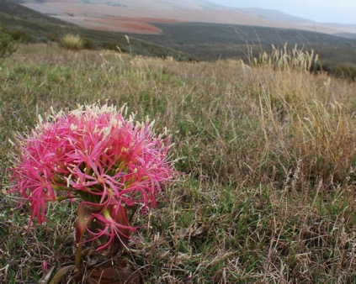

Some impacts cannot be offset
Impacts on irreplaceable biodiversity found in very few places and biodiversity that’s highly threatened can generally not be offset.
Two aspects of risk/feasibility:
Ecosystem found nowhere else
Offsets highly likely to be feasible
Likelihood of offset success
Offsets unlikely to be appropriate
Critically endangered cockatoo
See BBOP, 2012 Limits paper and Pilgrim et al., 2013
Level of Biodiversity conservation concern
Notes:
Exactly where to draw the line regarding limits to what can be offset is not totally straightforward. There are various factors to consider. Scientists use the concepts of irreplaceability and vulnerability as a guide – for those who are interested there is a more detailed graphic illustrating this in the corner of the slide.
Quite simply, the more threatened and thus closer to extinction a species or ecosystem is, such as these yellow-crested cockatoos which are listed as ‘critically endangered’, the more important is it to avoid impacts on such biodiversity. Rarely can an offset be designed that would compensate for losses to such biodiversity. The same applies to species and their habitat or ecosystems that are unique or highly restricted.

Slide 10
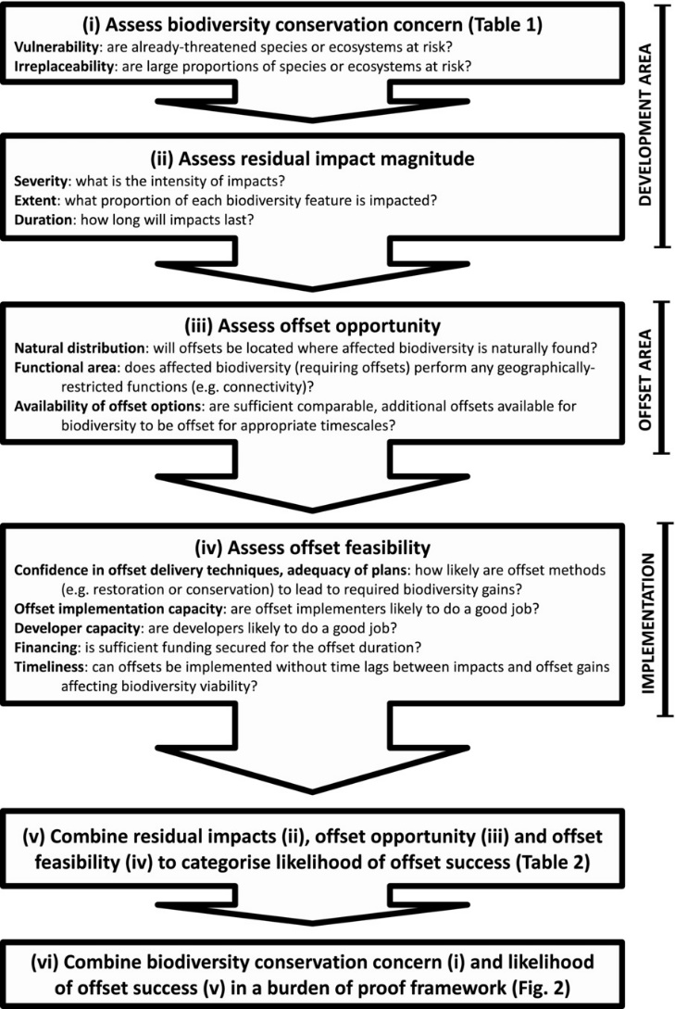
How to establish where there are limits and what to do?
How to handle possible ‘non-offsetable impacts’?
See e.g.:
BBOP 2012 Resource Paper: Limits to What Can Be Offset. https://www.forest-trends.org/bbop/resources/
Pilgrim et al., 2012. A process for assessing the offsetability of biodiversity impacts. https://doi.org/10.1111/conl.12002
What to do?
If it seems (e.g. during screening) that there is a risk of non-offsetable impacts on irreplaceable biota:
Do an assessment of need and desirability and a thorough alternatives analysis
Review the mitigation hierarchy and see whether project components can be redesigned so that any residual impacts could be offset.
Notes:
https://www.forest-trends.org/bbop_pubs/resource-paper-limits-to-what-can-be-offset/

Slide 11
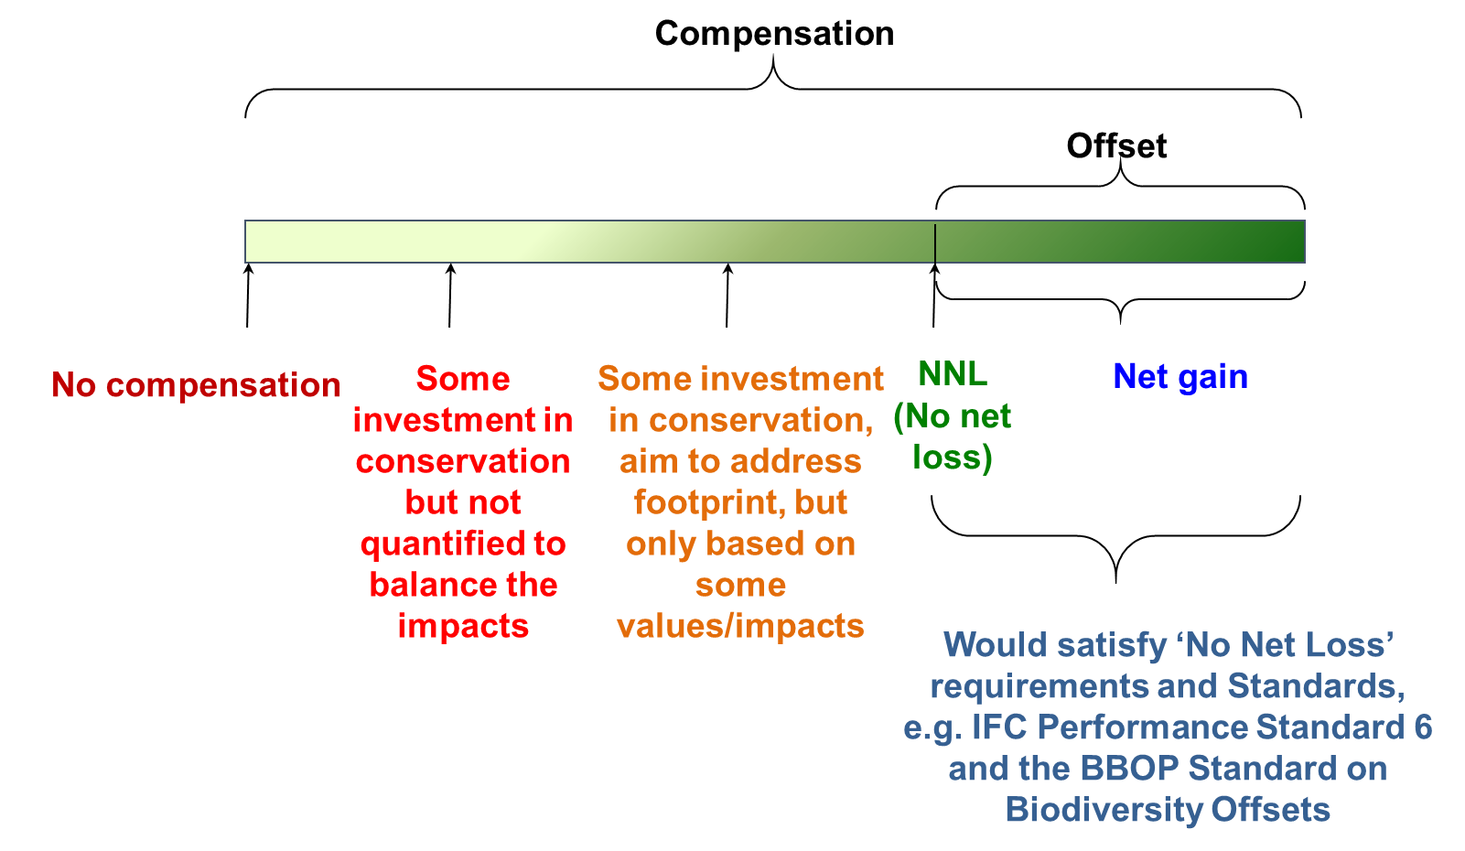
How to establish where there are limits and what to do?
What to do? Continued…
If there are no alternatives and no redesign could avoid the non-offsetable impacts, and if exceptional circumstances apply (e.g. project of overriding public interest)
Assess all potential impacts (direct, indirect, cumulative)
Design best possible mitigation
Undertake thorough regional studies to verify presence/ absence of affected biota
Quantify residual impacts, including – explicitly – the non-offsetable impacts
Do not claim NNL/BNG for the project as a whole
Design best possible compensation for residual impacts:
  For all ‘offsetable’ impacts, do compensatory conservation that results in generous BNG for those biota
  Identify biota closely related to the affected irreplaceable biota and deliver gains for these, if possible.
Notes:
https://www.forest-trends.org/bbop_pubs/resource-paper-limits-to-what-can-be-offset/

Slide 12
Key concepts
Spatial planning

Slide 13
Spatial planning & good decision-making
Good decision-making on biodiversity in the landscape & NNL or NG outcomes
  e.g. What to conserve, where, how much…? Where to enable project development?
Good (spatially explicit) assessment and planning
  e.g. Mitigation planning (facilitated through SEA, EIA), conservation planning, land use planning, …
  Relevant
  Accessible
  Updated
  Consolidated
  With guidance on how to use
  Integrated in DM processes
Data and information
Supporting systems, policy, coordination, capacity, etc.
Notes:
e.g. on Biodiversity values/ components (species, ecosystems, processes), on targets, drivers of change (+ / -)

Slide 14
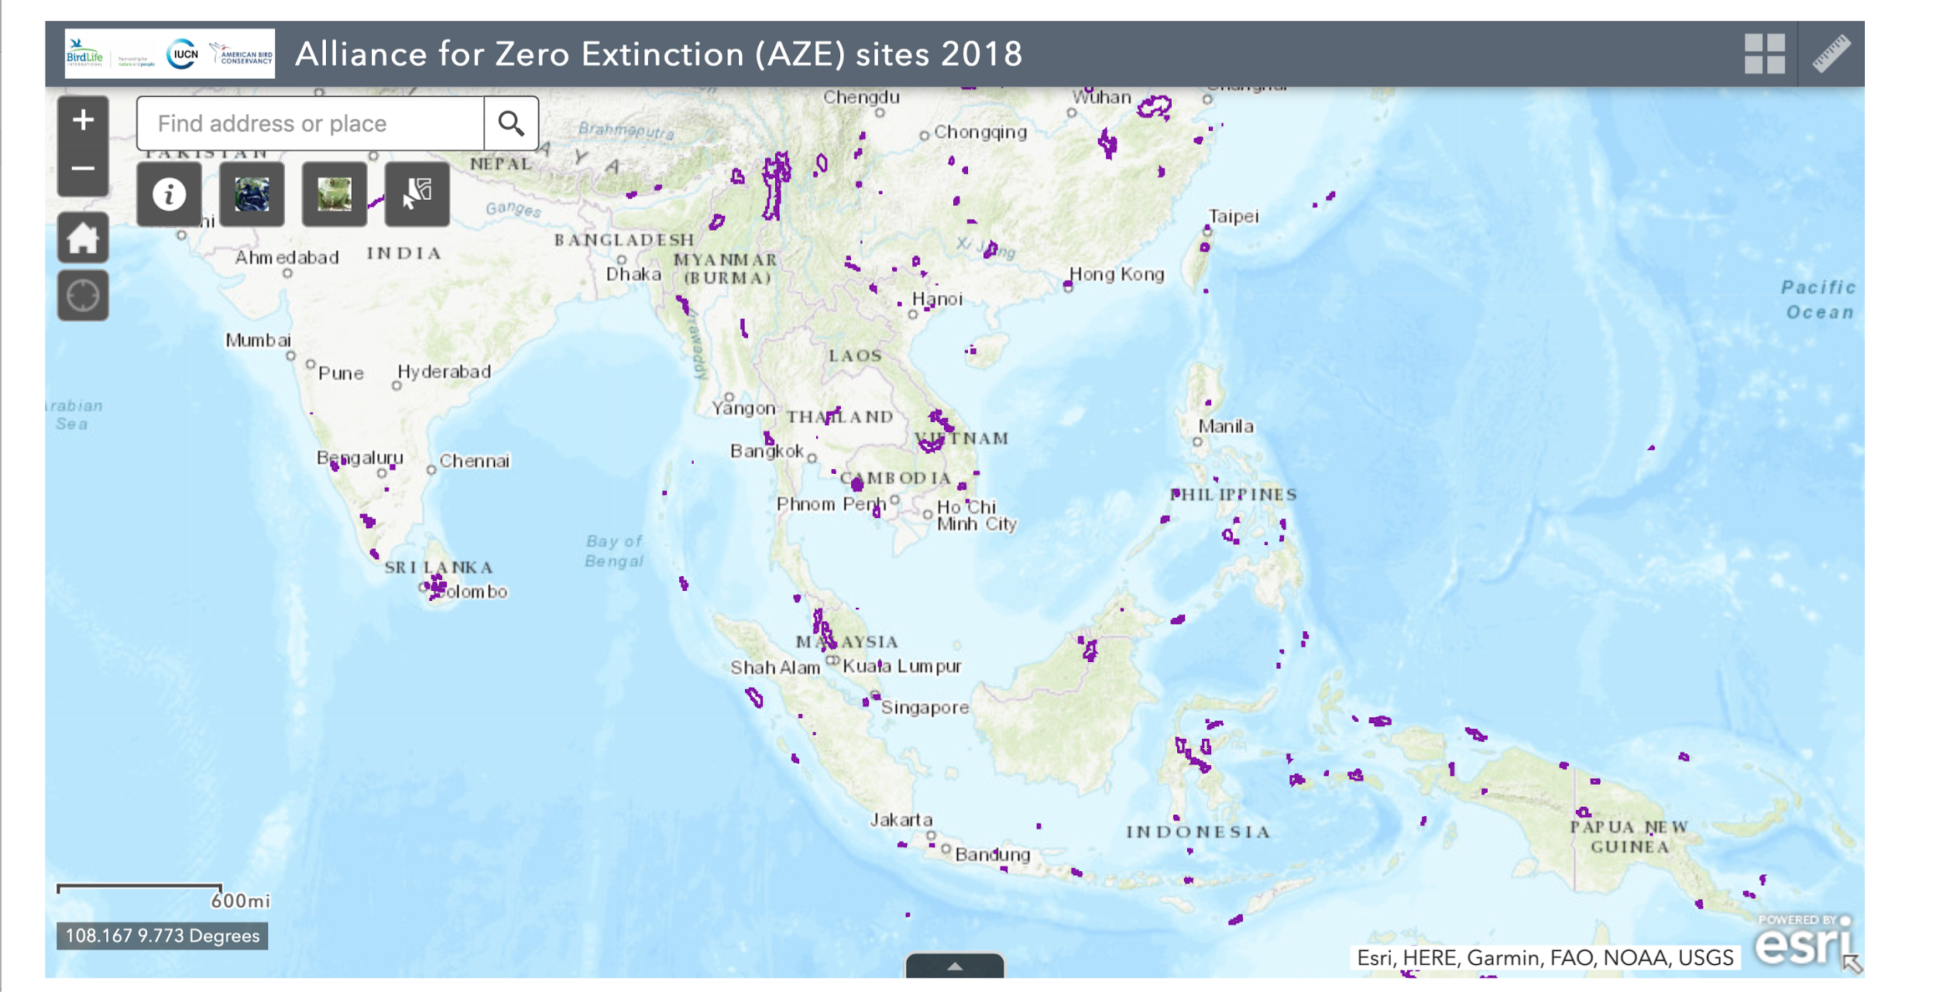
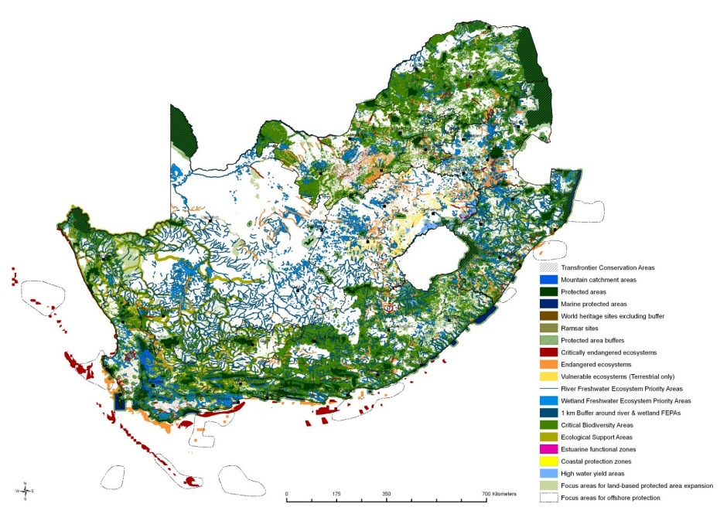
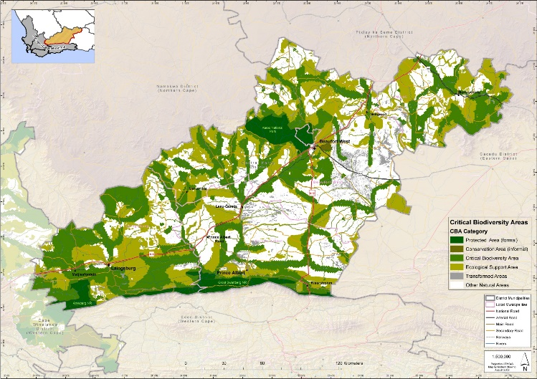
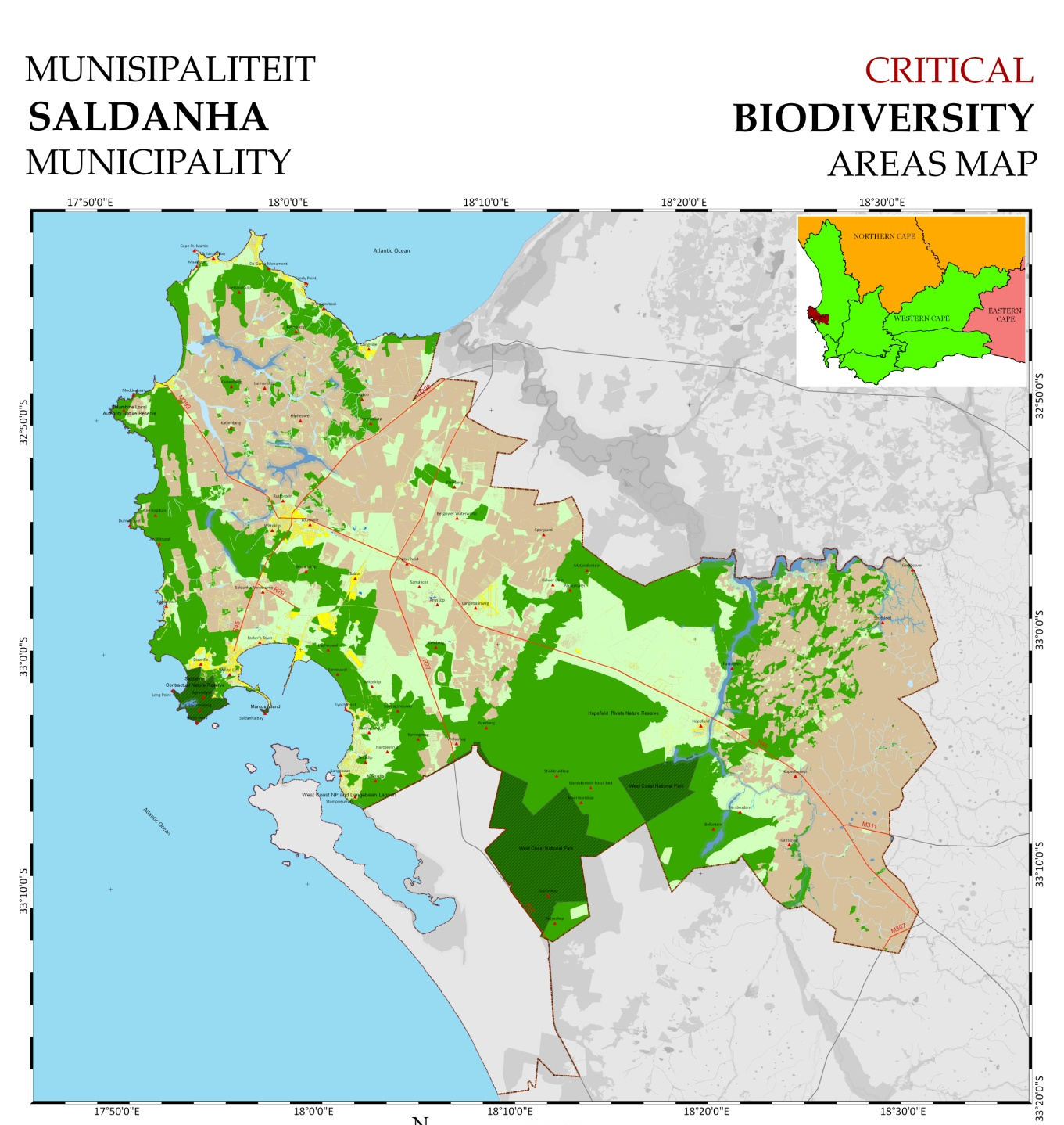
The mitigation hierarchy and spatial planning
Global
National
Provincial
Integration of the mitigation hierarchy, incl. id of biodiversity priority areas:
at various scales and
in different kinds of plans (conservation plans, spatial/land use plans, Strategic Environmental Assessment, EIAs, etc.
Local…
to
site-level
Underpinned by TARGETS

Slide 15
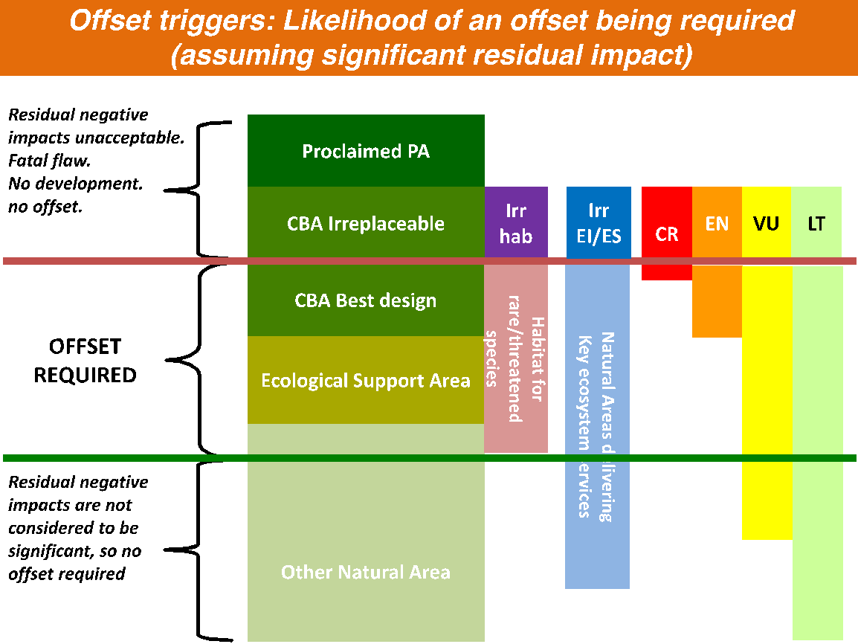
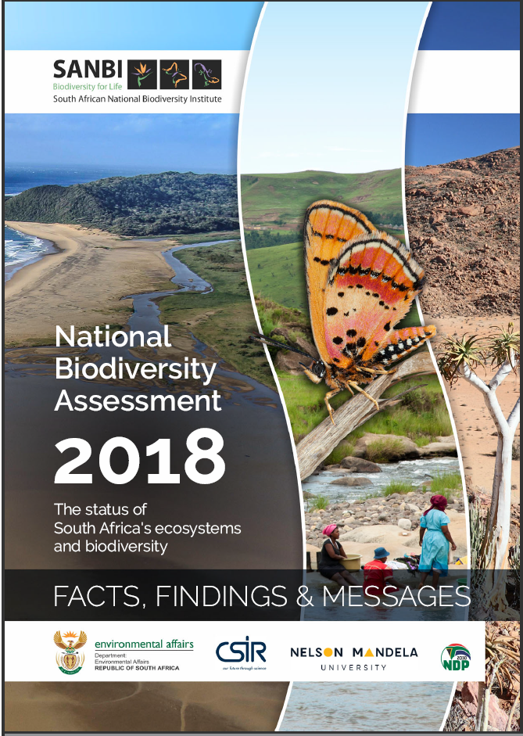
Spatial planning (e.g. at national level)
Spatial planning involves strategically assessing the economic, social, ecological and cultural goals and policies of society and making recommendations around space and resources.
Gives geographic expression to the policies of society
Includes: biodiversity/conservation planning, land-use plans, strategic environmental assessments, etc.
Integrates multiple planning goals – crucial to include biodiversity and associated ecosystem services.
Objectives should be informed by best practice, science, policy and stakeholders.
Various types of outputs useful for informing mitigation hierarchy (e.g. development zones, avoidance areas).

Slide 16
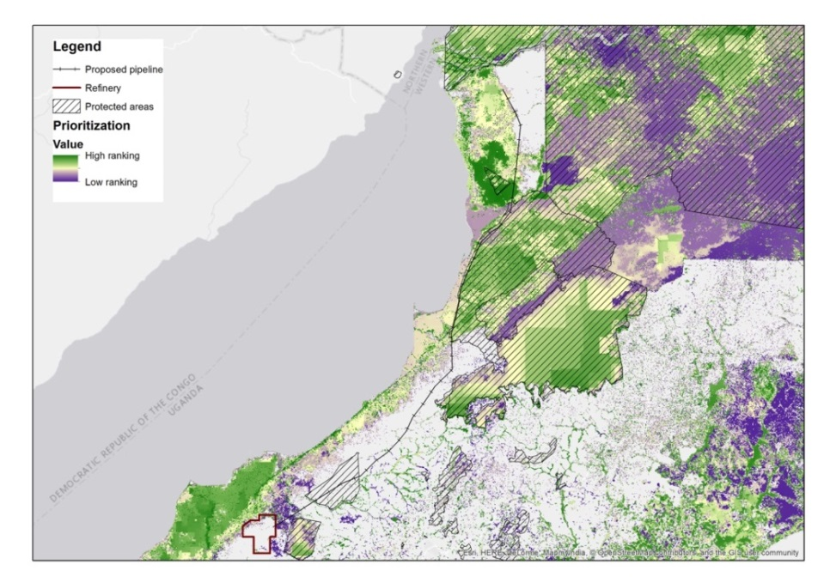
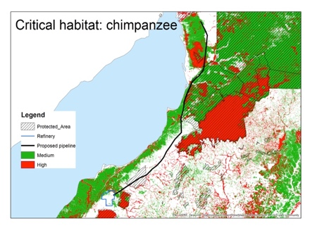
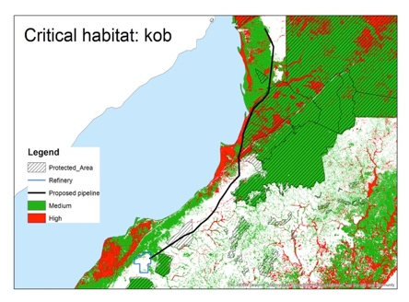
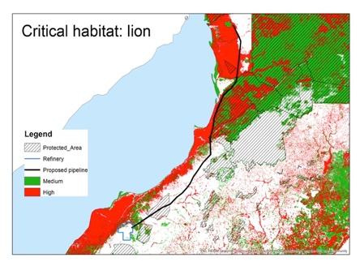
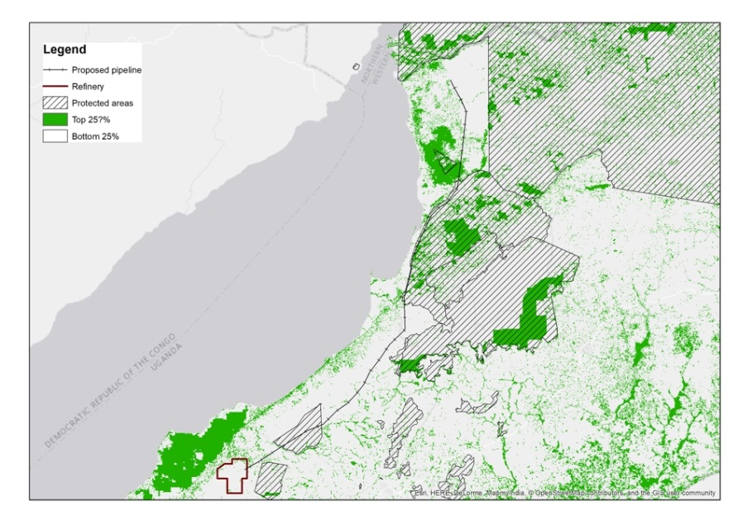
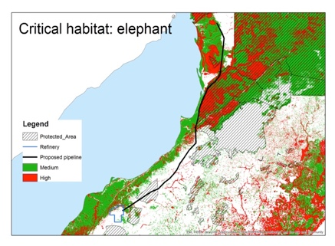
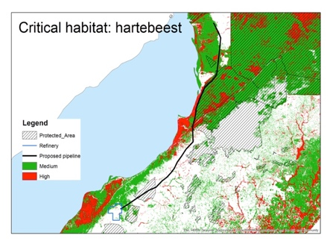
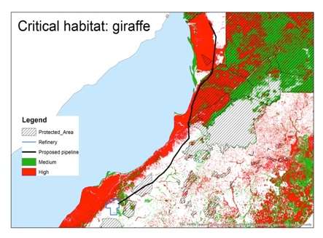




Spatial prioritization: combining multiple values together

Slide 17
Strategic environmental assessment
SEA is a systematic decision support process, aiming to ensure that environmental and possibly other sustainability aspects are considered effectively in policy, plan and programme making.
Good at dealing with specific issues, or specific sector issues
Notes:
SEA is an assessment, i.e. similar to an EIA but done at a different broader scale – for example for a bigger region and focused on a particular development sector such as oil and gas or mining - which allows more strategic considerations and the integration of environmental considerations into policies, plans and programmes.
Great to deal with sectors, issues, what people want, indirect and cumulative impacts

Slide 18
Key concepts
Additionality and Frame of Reference/ Reference scenarios

Slide 19
Additionality – what does it mean?
A core principle!
A biodiversity offset should achieve conservation outcomes above and beyond results that would have occurred if the offset had not taken place.
Why is additionality important?
Without additionality there is no real gain!
If there is no additionality, the developer is paying for nothing.
Notes:
‘Additionality’ is a core principle of biodiversity offsets. It is mentioned in most biodiversity offset laws and standards.
It means that the offset needs to produce something extra for conservation.
A common error in offset planning arises when biodiversity is lost in one area because of a project’s impacts and an offset area is ‘identified’ for conservation. (So far, so good!) But that’s not enough! If there are no restoration activities planned for the offset area (to improve condition) and no steps are being taken to stop it degrading against the background rate of loss, no difference is being made, so the project results in a net loss. There are questions about ‘no net loss’ when steps are taken to avert loss, too. (See the module on NNL/BNG.)
In brief, this is what is what these two boxes are saying:
Without additionality there is no real gain: If it’s not possible to show that the activities have led to new, additional conservation outcomes due to the offset, then nothing has changed.
If there is no additionality, the developer is paying for nothing: This means we don’t move towards the goal of ‘no net loss’, since we cannot show additional gains to balance the losses.

Slide 20
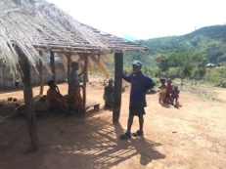
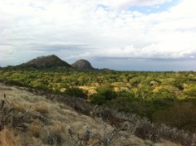
Why is additionality important?
Remember:
A project’s impacts will cause biodiversity loss here
An offset here is only additional if:
It increases the value through positive management / restoration or
It stops this area from being degraded or transformed, if the area is at risk of being lost
Notes:
[NB to Trainer: Here is an opportunity to distinguish between restoration (as third step in the MH) and restoration as a positive management action to deliver an offset.]

Slide 21


The many meanings of NNL and NG
More?
What will be the outcome for biodiversity?
The same as ‘now’ ?
Now
Less?
→ It depends on your frame of reference (and this is often not explicit).
Time
Notes:
NNL and even NG can mean many different things. Many of us implicitly understand NNL or NG to mean a neutral or positive outcome for biodiversity relative to where we are ‘now’ (or let’s say before a development project happens or relative to the state of biodiversity in 2018 in Country X). But, NNL or NG can also be framed differently – e.g. relative to what would happen without the development project and its mitigation measures, i.e. taking change over time into account.
And these two interpretations can mean a very different outcome for biodiversity.
This is something that trips people up. Why? Because we expect consistency: NNL or NG should mean the same thing in different circumstances. And of course we expect good biodiversity outcomes from these ‘gold standard’ policies and commitments. Yet this depends to a large extent on the frame of reference that is used.
Adding to the confusion is that many NNL or NG policies and commitments are not explicit about their frame of reference for losses and gains – i.e. relative to what is NNL or NG actually meant? Without knowing this, there is no clarity on what a policy will deliver for biodiversity at the end of the day.

Slide 22
Choosing a frame of reference:
NNL/NG compared to what? Some examples....
e.g. NNL/NG compared to ‘NOW’
Biodiversity
e.g. NNL/NG compared to a trend of biodiversity decline
Biodiversity
Now
Time
Now
Time
→ Do we accept a counterfactual of decline?
→ Or: Do we want biodiversity to remain where it at a specific point in time (e.g. now)
Note: Averted loss offsetting (through protecting existing habitat) is only possible against a baseline of decline.
Notes:
Demonstrating benefit is important for all conservation actions, so that we know we’re making a difference. But it is especially important when it comes to offsets because the gains from an offset must balance out specific biodiversity losses to reach NNL. The question is – NNL compared to what? We need to define a plausible counterfactual or baseline as our reference against which losses and gains are estimated.
At the policy level, which applies to an entire region or country for example, this is extremely important because when it comes to the goal of NNL, the chosen reference ends up being a self-fulfilling prophecy. If our choice is ‘NNL compared to now’ – which is a static baseline - we intend that biodiversity stays at its current level – e.g. across a region. The graph on the right hand side shows this. If instead we choose as our counterfactual a rate of biodiversity decline, then losses and gains are calculated with reference to this, and we maintain this rate of decline (shown on the left graph).

Slide 23
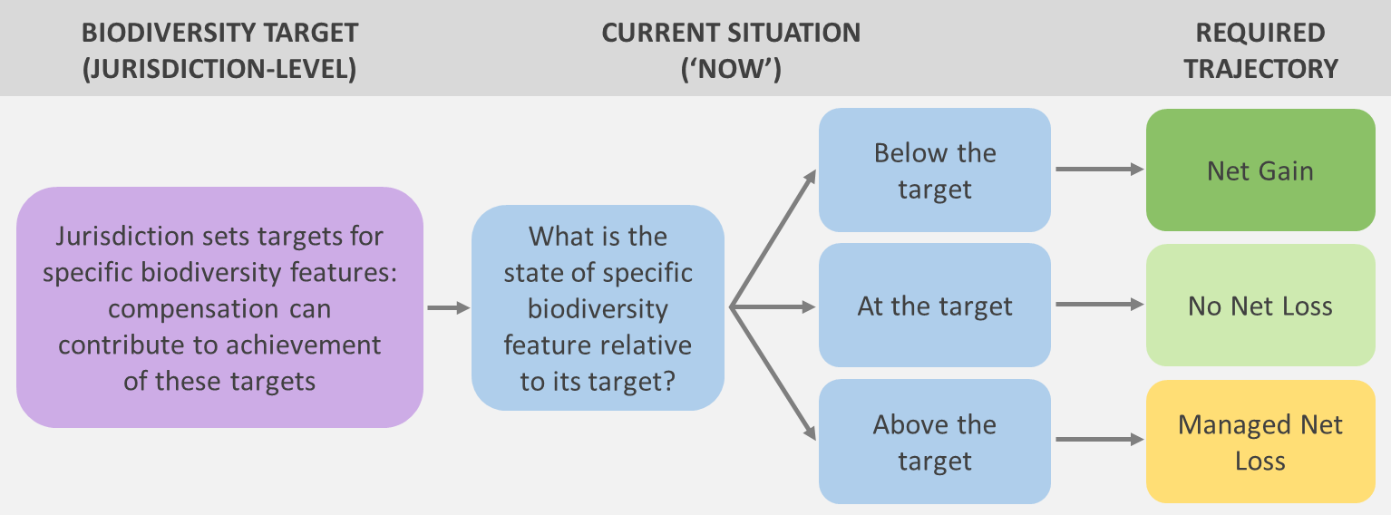
Choosing a reference scenario:
NNL/NG compared to what? Some examples....
→ Or: Do we want compensation to contribute to overarching biodiversity targets?
Target
The target could be above, at or in some cases below the current level of biodiversity!
e.g. NNL/NG compared to a desirable state for the relevant biota (i.e. a TARGET)
Biodiversity
Now
Time
Source: Simmonds et al., in press. Conservation Letters.

Slide 24
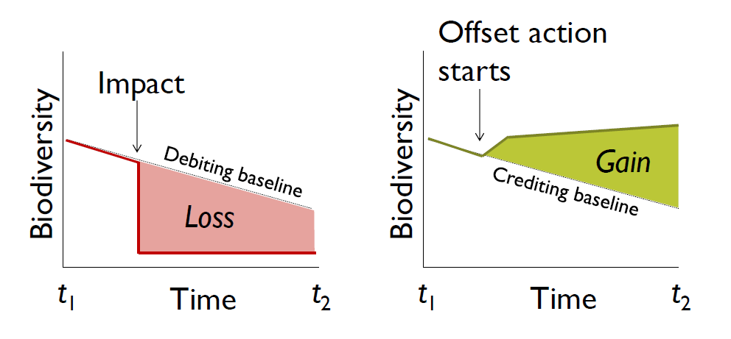
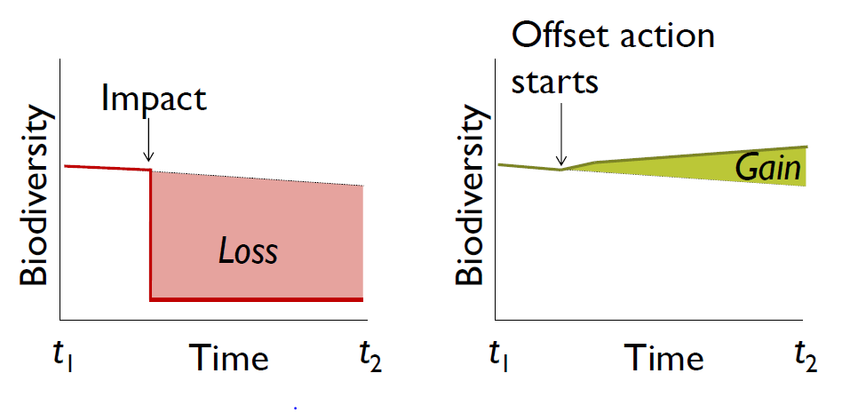
The frame of reference influences the outcome
For example, if different counterfactuals are used…..
Counterfactual / baseline of steep decline
Counterfactual / baseline of limited decline
Diagrams courtesy of Martine Maron, University of Queensland

Slide 25
Predicting and assessing biodiversity benefit
from conservation
A project needs to offset the loss of 10 Koalas
(Adapted from Maron, Rhodes & Gibbons, 2013)
Outcome with the conservation action
Outcome with the conservation action
10 New Koalas
Koala
Koala
Outcome without the action
Outcome without the action
10 Koalas that
avoided being lost
Time
Time
The benefit is the difference between the predicted outcome ‘with’ versus ‘without’ the conservation action.
Notes:
A very important thing to remember, when we talk about achieving real conservation outcomes, is that we need to measure the benefits of our actions. We want to make sure that we are making a difference – that our actions had led or will lead to an improvement relative to what would otherwise happen. This tends to involve predictions and scenarios. We need to compare the outcomes that we expect to occur with our conservation actions to the outcomes we would expect without the conservation action. As this simplified graph shows, the benefit for biodiversity is the difference between these two scenarios - the ‘with action’ and ‘without action’ (or counterfactual) scenario.

Slide 26
Predicting and assessing benefit
Trend and outcomes WITH the conservation action
The benefit of a conservation action is the difference between two scenarios, i.e. with and without the action.
Biodiversity value
WITHOUT the action
T = 0
(e.g. NOW)
T = 1
(e.g. in two years’ time)
Time
(Adapted from Maron, Rhodes & Gibbons, 2013)
Notes:
A very important thing to remember, when we talk about achievign real conservation outcomes, is that we need to measure the benefits of our actions. We want to make sure that we are making a difference – that our actions had led or will lead to an improvement relative to what would otherwise happen. This tends to involve predictions and scenarios. We need to compare the outcomes that we expect to occur with our conservation actions to the outcomes we would expect without the conservation action. As this simplified graph shows, the benefit for biodiversity is the difference between these two scenarios - the ‘with action’ and ‘without action’ (or counterfactual) scenario.

Slide 27
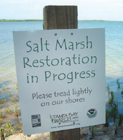
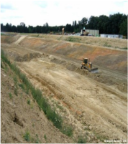
How to achieve gains? Key approaches to offsetting impacts on biodiversity
N.B. ‘On-the-ground outcomes!
Gains
Habitat creation or re-creation
Habitat restoration, e.g. through
  Planting, reseeding with native spp
  Re-introduction of native spp
  Addressing on-going threats
  Habitat protection/ averted loss
    Addressing on-going threats
Offsets
X
0
- X
Traditional conservation
Residual impacts
Losses

Slide 28
How to achieve gains?
Key approaches to offsetting impacts on biodiversity
Gains
Gains per hectare
Complexity & cost per hectare
Habitat creation or re-creation, if feasible
Habitat restoration
  Planting, reseeding w. native spp
  Re-introduction of spp
  Addressing on-going threats
  Habitat protection/ averted loss
Offsets
X
0
- X
Residual impacts
Losses
➔ Biodiversity offsets face the same implementation challenges as traditional conservation

Slide 29
Key concepts
Will restoration result in gains for biodiversity?

Slide 30
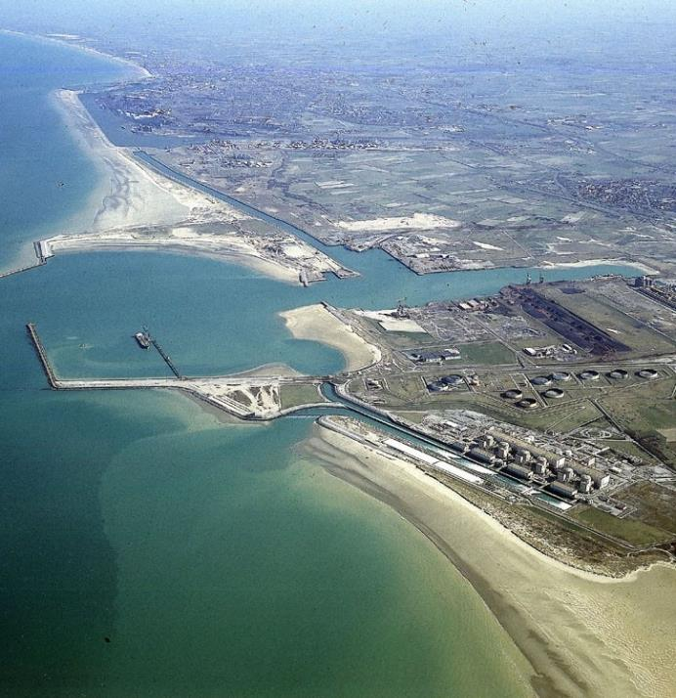
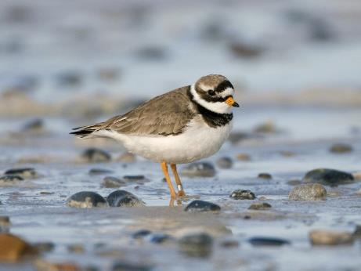
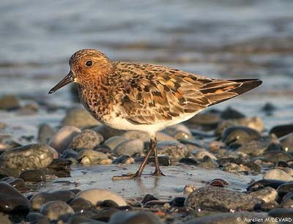
Can biodiversity be re-created?
LNG Terminal in Dunkirk (France)
Impacts on shorebirds
Creation of 20 ha of wetland habitat
Management as a new protected area

Slide 31
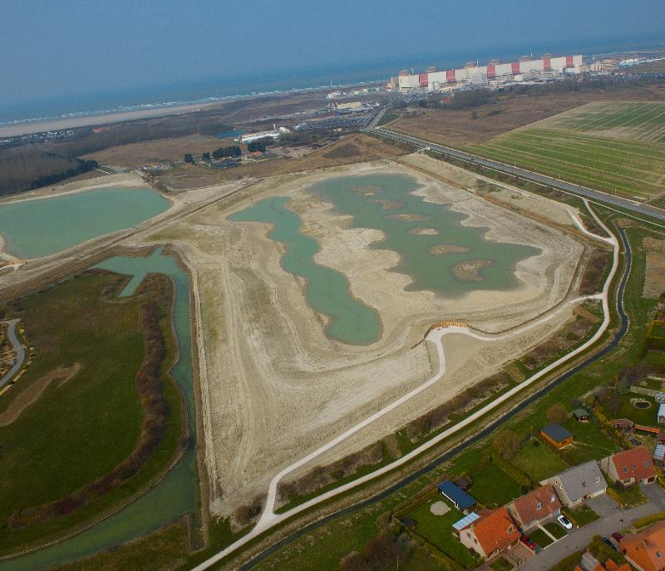
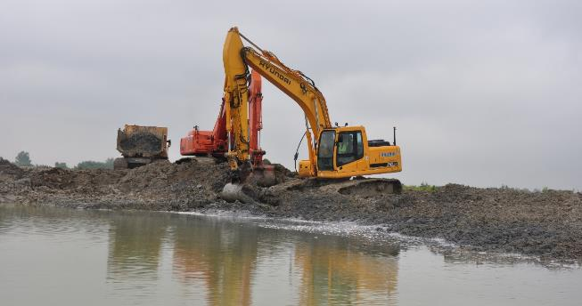
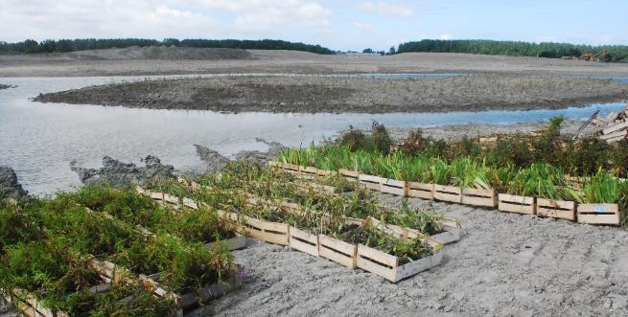
Habitat creation as a biodiversity offset
Habitat creation can be costly and will only work in certain specific contexts, but can provide tangible biodiversity gains

Slide 32
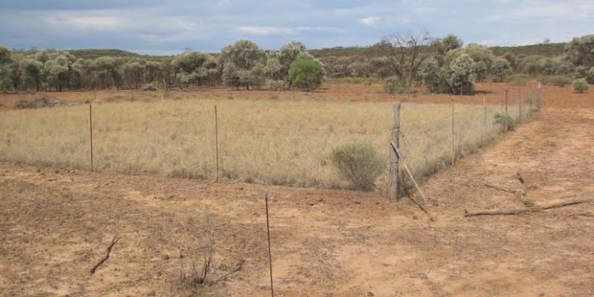
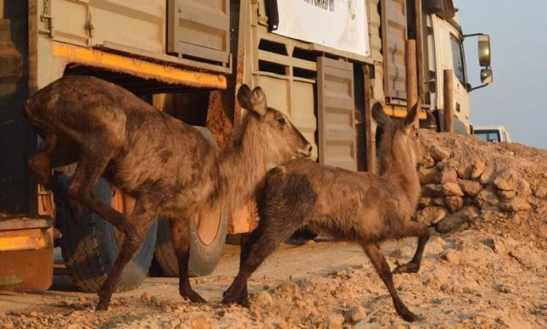
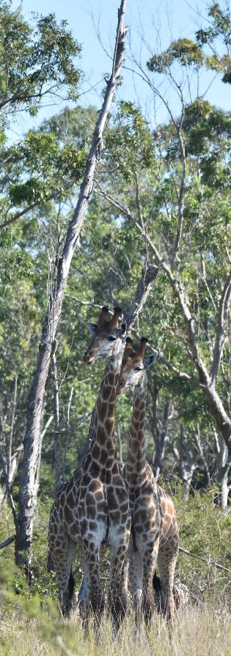
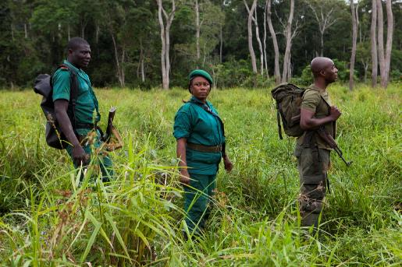
Can ecological restoration be used to offset impacts?
Restoration can take many forms
Passive restoration: stop ongoing degradation
Wildlife reintroductions
© Mike Goldwater, WWF
Active restoration of vegetation
Maputo Special Reserve

Slide 33
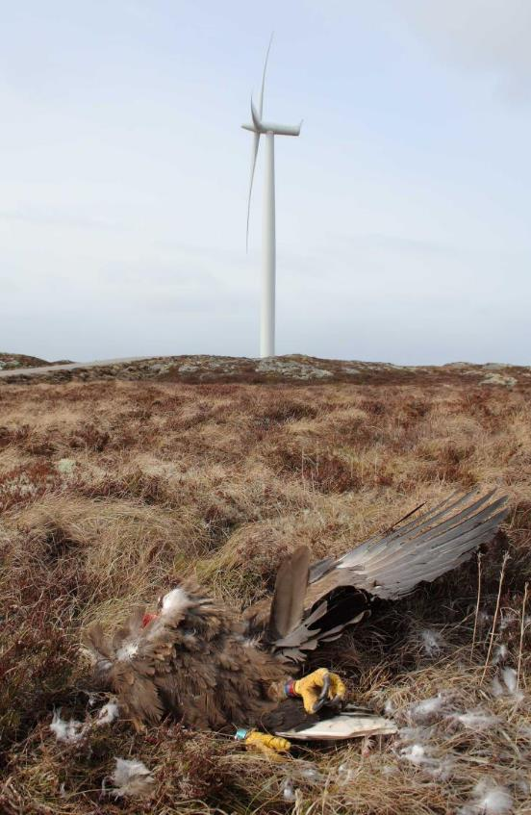
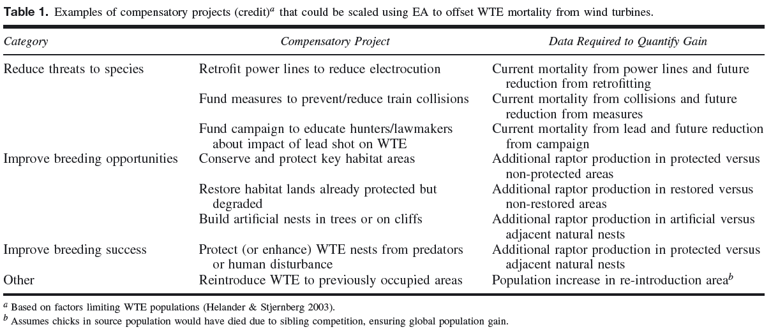

Restoration = addressing key factors
Decrease mortality
Increase breeding opportunities
Increase breeding success
Other
Retrofit existing powerlines
Decrease vehicule collisions
Decrease use of lead bullets
Protect key breeding habitat
Restore degraded breeding habitat
Build artificial nests
Protect nests from people and predators
Reintroduce to previously occupied areas
➔ What is the limiting factor for maintaining
or expanding the target population?
Photo: Francesco Veronesi
Photo: Espen Lie Dahl
Cole (2011) in Restoration Ecology 19(2), 147-153

Slide 34
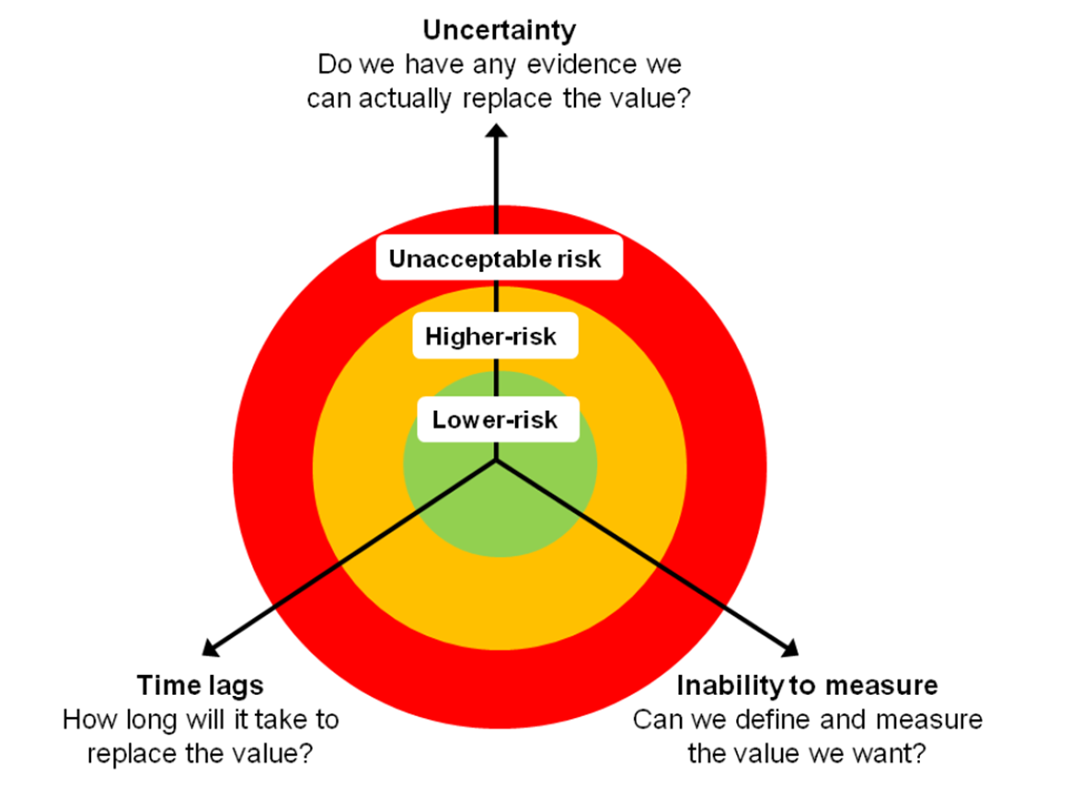
Restoration – what to consider?
(Source: Maron et al., 2012. Restoration realities in the context of biodiversity offset policies. Biological Conservation 155)

Slide 35
Offsets through restoration
Natural vegetation
No Net Loss
Cleared/developed
New development (regulated impact)
Unregulated impact
Protected (averted loss)
Restored
Net Gain
Restoration doesn’t always work and can take time
The impact – offset ratio determines the final outcome

Slide 36
Key concepts
Will protection result in gains for biodiversity?

Slide 37
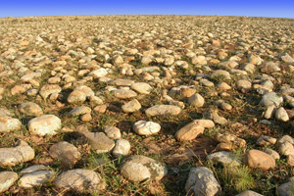
Can biodiversity protection be used to offset impacts?
A typical offset in France from a decade ago
Pipeline crosses 6ha of protected steppe habitat
Offset through the purchase of 70ha of existing habitat (at <2% of project cost)
Land handed over to a local NGO
(regional nature reserve status)
No funding for the management of the offset site!
x 10
Crau sèche © A. Wolff - CEEP
Is this “no net loss” of biodiversity?

Slide 38
Can protection be used to offset impacts?
Project-level approach
(e.g. 2:1 ratio)
Starting landscape
Landscape outcome
Natural, unprotected habitat
A 2:1 ratio means you lose 1/3 of the habitat present at the start
Protected habitat
Converted habitat (regulated development impact)
Simply adding protected areas leads to a net loss of biodiversity overall
The impact – offset ratio determines the final outcome

Slide 39
What about funding ‘paper parks’?
A 2:1 ratio means you lose 1/3 of the habitat present at the start
Natural vegetation
New development (regulated impact)
Protected (averted loss)
The same is true for funding of ‘paper parks’
The impact – offset ratio determines the final outcome

Slide 40
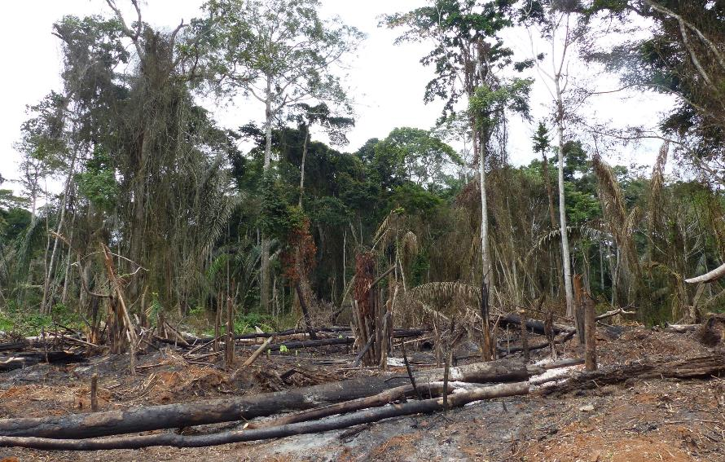
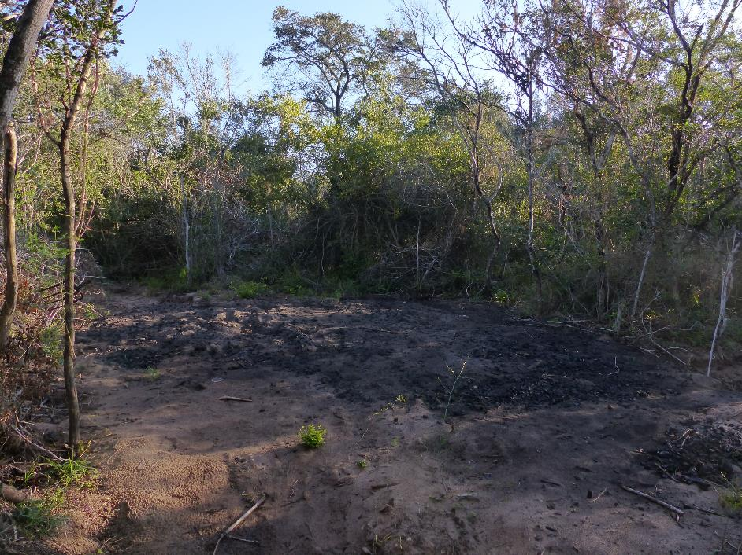
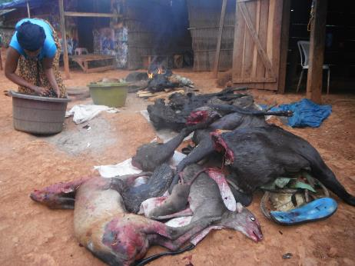
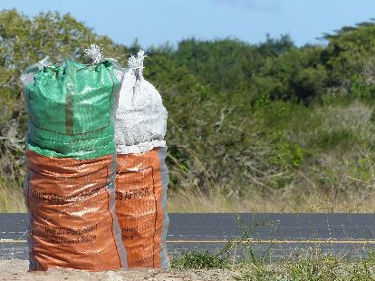
What about addressing unregulated impacts?
© Fabien Quétier, Biotope
Slash-and-burn agriculture
Hunting & poaching
Charcoal production in Licuati Forest Reserve
© Zebene, WWF

Slide 41
What about addressing unregulated impacts?
No Net Loss relative to what?
Unregulated impacts mean more net loss
≠
With offsets
Without offsets
Natural vegetation
New development (regulated impact)
Protected (averted loss)
Cleared/developed
Unregulated impact
Restored

Slide 42
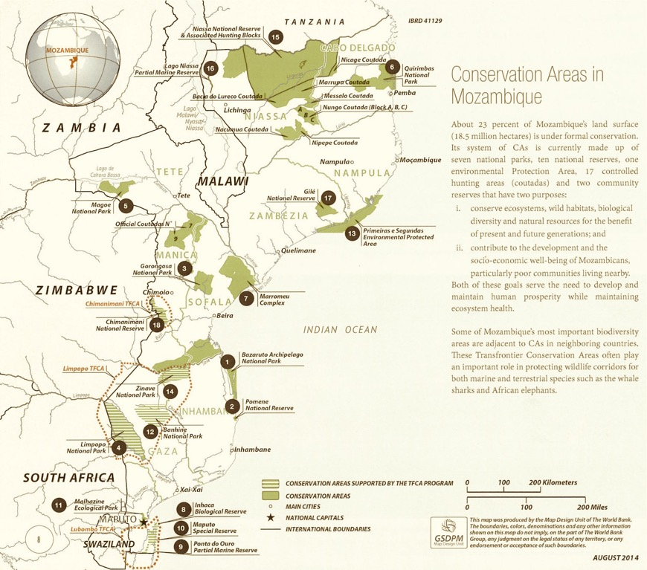
Can offsets within protected areas
be 'additional’?
Government has an obligation to conserve protected areas.
So how can an offset take place in a protected area? Surely there would be no additionality?
This is quite controversial and there is no internationally agreed answer.
It probably depends: Can you can show that conservation outcomes from the offset in the protected area are additional to what would have happened without the offset?
That may be OK.
How could this be proved?
→ Biodiversity Offset Management Plan for activities beyond what’s in the Protected Area Management Plan?
→ Budget for offset is extra, on top of the budget for the Protected Area?
Notes:
One of the controversial issues about biodiversity offsets is whether it is legitimate for them to be implemented within protected areas.
It is generally agreed that creating a NEW protected area is additional and is an appropriate way to undertake a biodiversity offset.
The controversy lies with offsets proposed within existing protected areas. There are good reasons to consider this possibility. For instance, the land tenure of protected areas is often clear and dedicated to conservation, whereas securing long term conservation tenure may be hard outside protected areas. However, existing protected areas should be exactly that: already well-protected! So where is the additionality?
It all depends on the circumstances. In some situations good arguments could be made that conservation outcomes through the offset in the protected area are over and above what would have happened in the area without the offset.
But – how could this be demonstrated?
Ideas on how this could be proved:
Biodiversity Offset Management Plan for activities beyond what’s in the Protected Area Management Plan?
Budget for offset is extra, on top of the budget for the Protected Area?
Consider factors such as governance and track record of the country with protected areas.
It’s important to note that this is an extremely controversial topic in international discussions. Any country developing a system for mitigation including biodiversity offsets will need to give it serious thought and follow the debate as standards of good practice emerge.

Slide 43
Protected area and offset policy contrasted
PROTECTED AREA POLICY
BIODIVERSITY OFFSET POLICY
Avoid impacts in PAs.
Any offsets in PAs must be ADDITIONAL.
Need to discuss scope!
CARR
Comprehensive
Adequate
Representative &
Resilient
— and —
Relevant to the community
Resilient to climate change
Viable into the future
No Net Loss
(or Net Gain)
For all impacts
(Not just impacts on protected areas)
Offsets in a variety of locations (not all in PAs?)
Avoid
Minimise
Restore
Offset
Implementation mechanisms:
Trust Fund
Benefit-sharing agreements
Capacity building

Slide 44
Key concepts – Take home messages
The mitigation hierarchy is a vital tools to enable governments and companies to reconcile development and biodiversity conservation goals, as explained in an earlier module.
While the design phase of mitigation is of relatively short duration (often integrated with impact assessment), implementation is a long term exercise that should last as long as residual impacts, often for several decades or more.
There are limits to the losses of biodiversity that can be offset, and methods to explore vulnerability and irreplaceability of biodiversity so these limits can be established in policy and case-by-case.
Spatial planning is important for applying the mitigation hierarchy, at the national level, at the regional or provincial level and down to the local level. Spatial planning enables multiple different biodiversity values to be combined, which is useful for many purposes, from land-use planning, to conservation planning and to planning of mitigation measures.
Biodiversity offsets must demonstrate that an outcome for conservation that would not have happened without them. The baselines for mitigation measures must be clear.
Conservation gains that are additional can be achieved in two different ways: restoration and protection (or averted loss), but the latter only if you are prepared to accept a baseline of decline. Clarity is therefore important on two questions: BNG/NNL of what, and compared to what?
A controversial issue is whether offsets within protected areas can satisfy the text of additionality. Two aspects of demonstrating this could be a Biodiversity Offset Management Plan and budget that goes beyond the current Protected Area Management Plan and budget.

